Slide 1
Slide 1
ADVANCED LESSON FOR GRAPHS & CHARTS
Speaking 14

Slide 2
Slide 2
SAMPLE
2

Slide 3
SPECIAL TERMS

Slide 4
TYPICAL DESCRIPTION

Slide 5
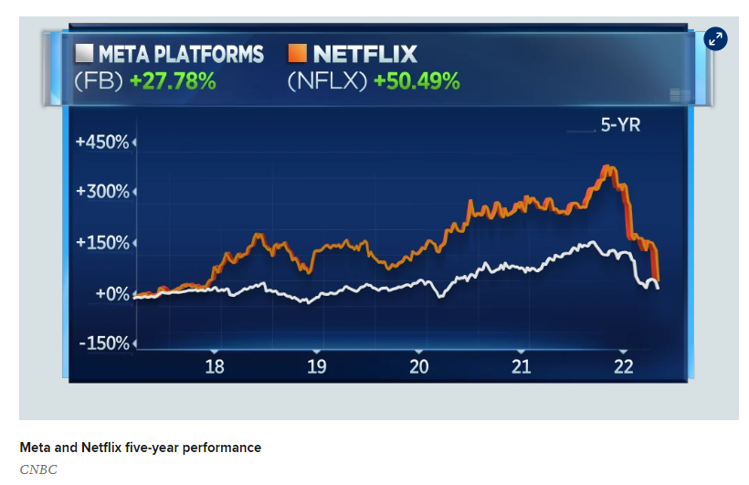
Slide 2
PRACTICE
2

Slide 6
Slide 11
THANK YOU

